Slide 1
Azure Migration
Kit Skinner
Senior Cloud Training Architect
Opsgility
Notes:
Welcome to Azure Migration discussion.
My name is Kit Skinner, Senior Cloud Training Architect with Opsgility.

Slide 2
Agenda
Migration Resources and Tools
Migration Assessment
Lift-and-Shift Migration
Database Migration
New Features of Migration

Slide 3
Migration Resources and Tools
Notes:
We'll begin with a review of the resources and tools that are available when you're considering migrating on-premises workloads to Azure.

Slide 4
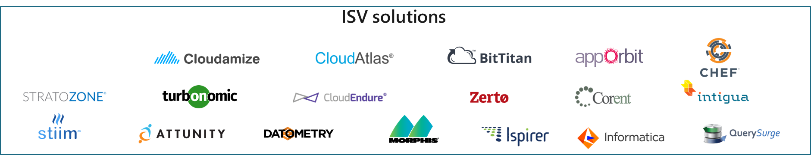
Migration Phases and Tools
Assess
Migrate
Optimize
Secure and manage
Azure Migrate
App Service Migration Assistant
Data Migration Assistant (DMA)
SQL Server Migration Assistant (SSMA)
Movere
Azure Migrate
Azure Site Recovery (ASR)
App Service Migration Assistant
Azure Database Migration Service
Azure Data Box
Azure Cost Management
Azure Advisor
Azure Policy
Azure Blueprints
Azure Security Center
Azure Backup
Azure Monitor
Azure Update Management
Notes:
Each of phase of Azure migration has process driving it, but also tooling.
<CLICK> For assessment, you'll find assessment tools from Microsoft for servers – both physical and virtual with Azure Migrate – as well as tooling that is specific to migrating websites such as the App Service Migration Assistant. There is also database specific tooling in the Data Migration Assistant, or DMA, the SQL Server Migration Assistant, or SSMA. There is also the new Movere tools to help a varying degree workloads as well.
<CLICK> When it comes to migration tooling, you'll find Azure Migrate and Azure Site Recovery. Also notice that App Service Migration Assistant and Azure Migrate are listed here again as well – that's because the App Service Migration Assistant and Azure Migrate are both an assessment engine and a migration tool in some scenarios.
<CLICK> When we consider optimization, cost controls certainly come to mind, and we'll most likely look to Azure Cost Management and Azure Advisor to help us understand our running cost and where tweaks can be made as well as tools like Azure Policy to help us meet our governance goals. Just a quick note on cost here – no matter how much time you spend in the Assessment phase of your migration, you'll probably miss something that comes as surprise later for cost – remember, just because you've migrated doesn't mean your work is done.
<CLICK> And in that same vein of your work isn't done yet, we also have Azure Security and Management. There are a number of tools at your disposal here, including Azure Blueprints to manage your Azure estate, Azure Security Center, which includes a free tier that everyone should use, and Azure Monitor for monitoring not just your workloads but also your overall service health in Azure, and Azure Backup and Azure Update Management to help you backup and patch your VMs in Azure.
<CLICK> Now, all of those are your Azure options. One of the benefits of a service like Azure Migrate is it integrates with 3rd party solutions as well for across this continuum. Say you want to use ASR to move your workload but you already have a Cloudamize license for assessing your existing workloads – in the current migration landscape Microsoft has made this pretty easy!

Slide 5
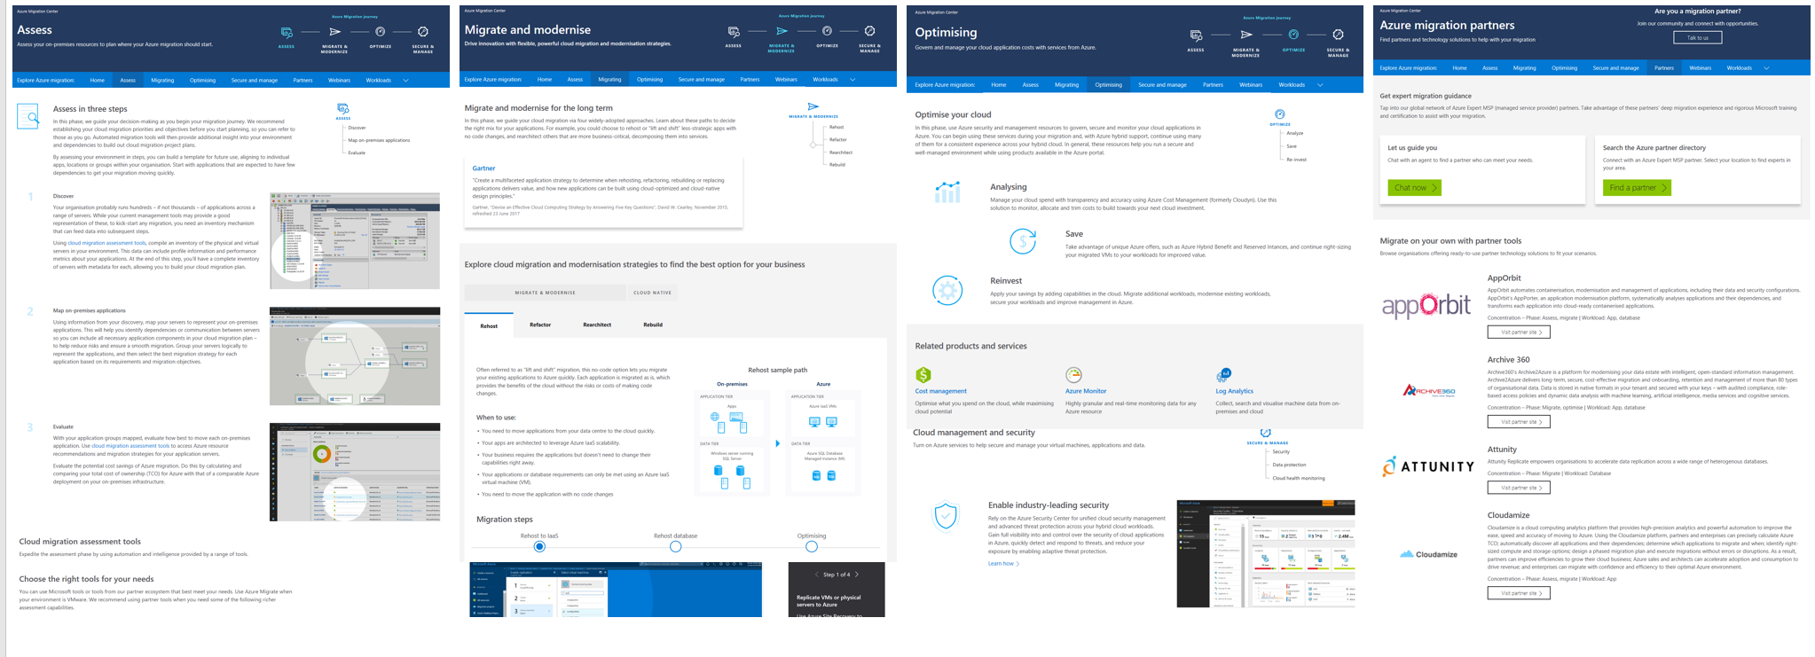
Azure Migration Center
https://azure.microsoft.com/migration
Notes:
If you're just getting started on your migration journey, documentation is one of your best friends and Microsoft has some great options for understanding the all up process that you can potentially use to help your stakeholders understand the process. Engaging your stakeholders early and often is going to be key to your success and one resource you can point them to is the Azure Migration Center. The migration center covers all stages of a migration project, from strategy, initial assessment, through app and data migration, to post-migration optimization, security and management as we just discussed with the tooling.
I really like the migration center because its consumable for business users who aren't necessarily making technical decisions but need a sense for where they are and what's coming next. The other nice thing is it's not just for servers, its for other workloads like databases as well.

Slide 6
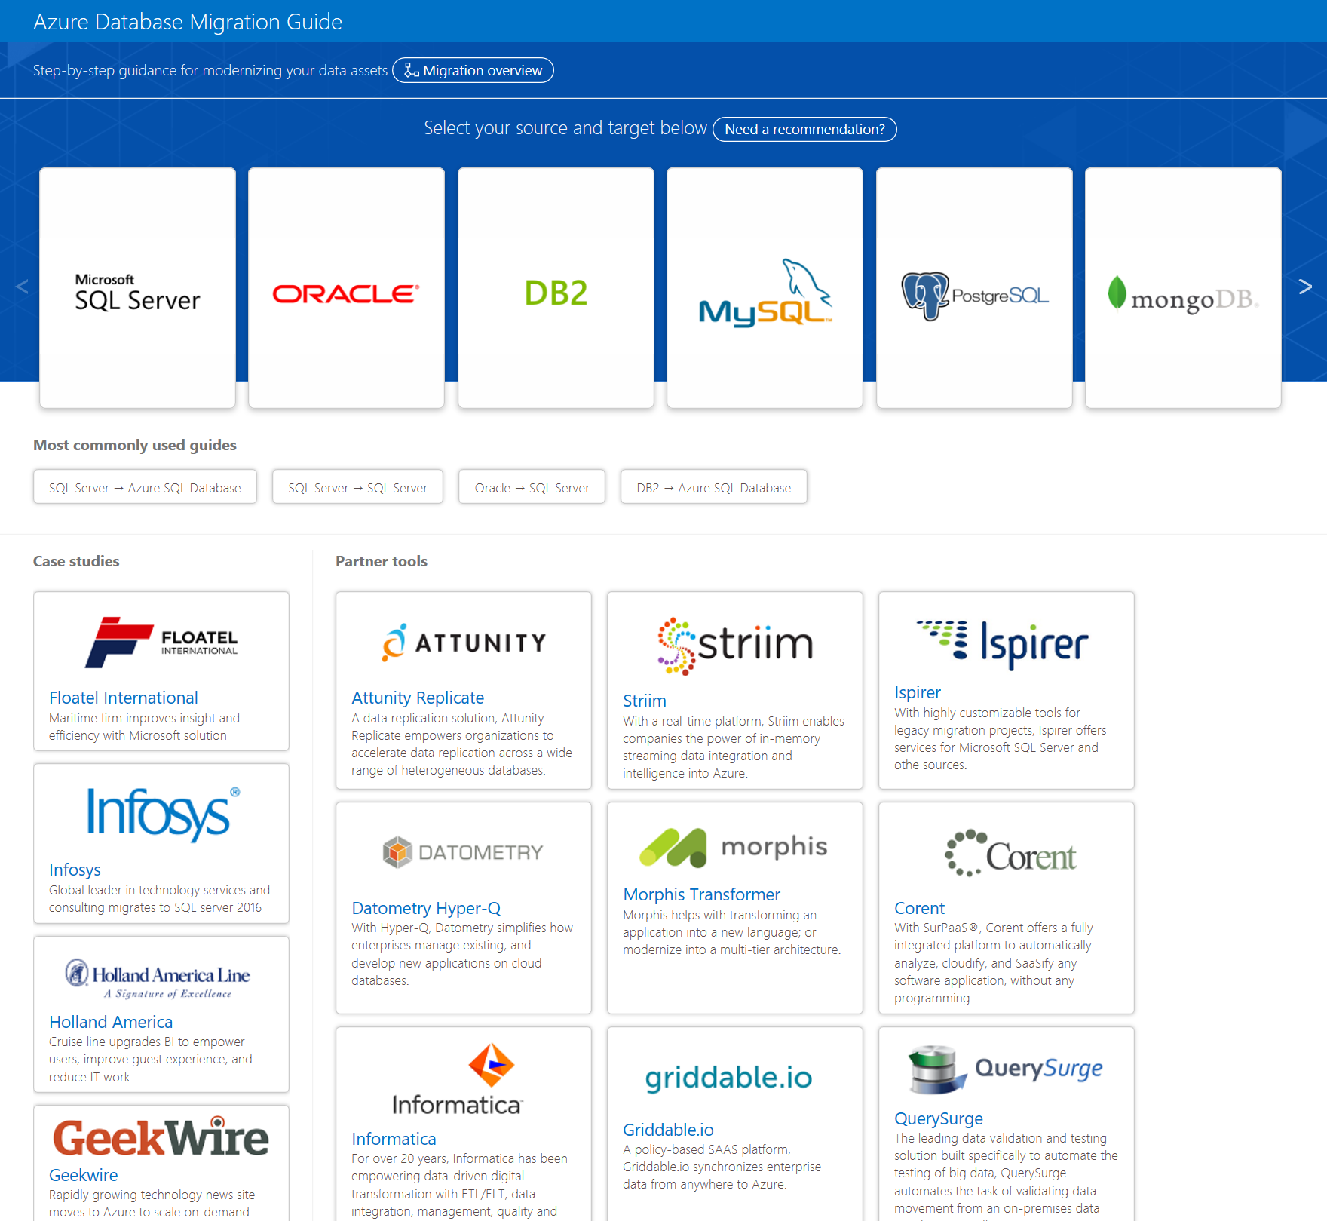
Azure Database Migration Guide
Select source and destination databases
Tool recommendations
Step-by-step data migration guides
https://aks.ms/datamigration
Notes:
Speaking of databases, there's also the Azure Database Migration Guide. This guide is very handy when it comes to being able to select your source database and understanding what your options are to not only migrate your data, but also any programmatic changes that might need to occur. For example, let's say you use MongoDB on-premises and want to migrate to CosmosDB in Azure. You'll get not only the step-by-step migration guide but also access to how you should configure your landing zone in Azure. In this case, if you want to maintain Mongo compatibility, you'll be directed to make sure you enable the Mongo APIs for Cosmos DB.

Slide 7
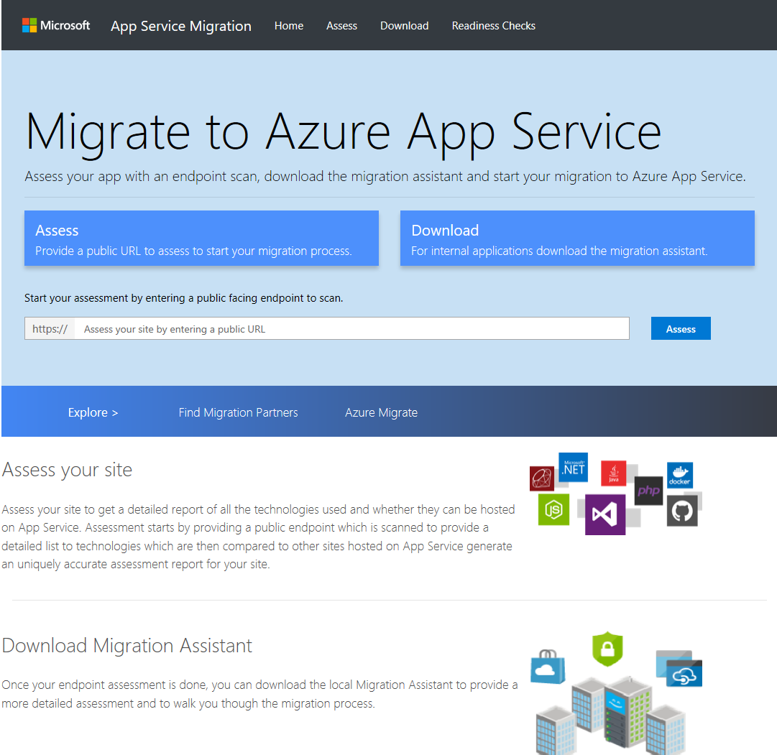
App Service Migration
Web-based assessment of Internet-facing sites
Download the Migration Assistant for deeper assessment, Intranet sites, and migration
https://appmigration.microsoft.com
Notes:
If you're interested in migrating a web-based workload to Azure and don't want to move to VMs or want to make the step to transition straight to App Services, you might want to explore the App Service Migration Assistant.
This tool runs in two modes – one where it can assess a public facing website or one where you can download an executable to that can be run on the local server hosting your workload. If you decide to migrate to App Service, you can execute your migration using the same tool.

Slide 8
Migration Assessment
Notes:
Now that we've seen a bit of the ecosystem, let's take a look at performing an assessment for a migration and how to build an assessment plan.

Slide 9
Build a Migration Assessment Plan
Discovery
Business context
Migration goals
Applications
Infrastructure
Requirements
Pain points
Notes:
Your assessment plan is going to start with discovery. There's a few things we want to address here.
What's the business reason you're performing the migration? Is it because some on-premises infrastructure is being retired? Is there another driver such as someone saying "Let's go to the cloud!" without understanding the impacts? If you can properly frame the problem you're trying to solve with the migration of your workload to Azure, you'll be better positioned to make downstream decisions. Beyond business context, you'll also want to clearly state the goals of your migration. If your goal is to migrate for the sake of migrating that might not work out as well as you think, but if your goal is to migrate to Azure for greater resiliency or better performance you'll have a better foot to stand on when it comes to framing out your landing zone in Azure.
You'll also want to take an honest assessment of what you're looking to migrate right now – focusing on a smaller app first can help you build confidence in the cloud and understand the ins and outs of the tools that you'll select to perform your migration.
And just a quick note here – while we're talking about planning, we're likely deploying tools that can help us come up with our plan. For example, to understand by current infrastructure for my source workload, including server sizing and networking requirements, I might be deploying Azure Migrate in this phase to help me make some informed decisions as I move into planning my migration.
When it comes to discovery, there are two paths you'll want to go down. One of course is to identify and interview your key stakeholders. Stakeholders includes everyone who needs to be informed of the progress of the migration or is impacted by the migration. This might sound like a lot, but its important!
You'll likely have executive sponsors who need to be kept in the loop in addition to application owners and end users. If you don't know your executive sponsors and have a good relationship with them, what happens if something go wrong during your migration and an application owner goes over your head? You also likely won't be communicating directly with end-users and are going to need the assistance of those executive sponsors and application owners to maintain transparency as you migrate your workload.
While you're identifying your stakeholders, you can also start down the technical path and being evaluating and running discovery tools. This could in fact help you close the loop quicker with sponsors as you can come to them with a plan earlier.
And even if you think you're only going to migrate one workload, there are likely more in the future. Make sure that you're investing not in the tools, but more critically the skills you'll need to execute more migrations in the future.

Slide 10
Build a Migration Assessment Plan
Discovery
Planning
Business context
Migration goals
Applications
Infrastructure
Requirements
Pain points
Overall migration approach
Detailed migration design
Migration schedule
Notes:
The next phase of your Assessment plan will be planning. Now that you have a sense of what you're trying to migrate and most importantly WHY you're migrating the source workload, you can start to drill into your overall approach to your migration and a detailed design. Keep in mind, we're still planning here and plans can change, but by laying down a foundation now you'll be able to understand where things go right and where things go wrong later so you can adapt your approach as you migrate additional workloads.
Just a note on migration schedules – keep in mind that your schedule isn't just how long it takes to move some data and stand up the workload – it needs to include all of the time for testing and validation from your stakeholders as well as the time you'll need to commit to building out a landing zone in Azure for your application.
If you're just getting started with Azure today, there's some other prerequisite work you'll want to do around identity and organizational governance before you start migrating workloads and lighting up services. I highly recommend taking a look at the Cloud Adoption Framework to understand some of your considerations as you build out that landing zone.

Slide 11
Build a Migration Assessment Plan
Discovery
Planning
Evaluation
Business context
Migration goals
Applications
Infrastructure
Requirements
Pain points
Overall migration approach
Detailed migration design
Migration schedule
Migration plan review
Risk assessment
Cost analysis and business case
Go/no-go
Notes:
The last phase of your assessment plan buildout is going to be the evaluation phase. Hopefully at this point you’ve done some business analysis and technical analysis of the workload you're going to migrate. Now is your chance to review your all up plan, make sure you have stakeholder buy-in, and that everyone understands the risks involved.
I think it's a good idea to perform a cost-analysis as well. Remember, you're hosting on top of someone else's platform. Act like a reseller and treat each of your stakeholders as customers who are going to get an itemized bill for the resources they run in Azure, whether you mean to actually charge them back or not. If you approach it this way, you'll hopefully catch some things that some of the automated tooling misses for cost. For example, while Azure Migrate will tell me how much it's going to cost to run my server each month, it doesn't help me calculate my network egress costs or costs for backup and recovery. The reality is there are going to always be some unknowns, but you can take this time to perform the best assessment you can before you click the go button.
And what about the go button? Sometimes, that needs to be a no-go button as well. Make sure you've framed out a clear set of criteria for when it's OK to start your migration and when you need to pull the plug if something goes wrong.
Ultimately, I think there are a few questions you can ask yourself along the way that will help you frame the best plan you can, such as:
What applications and infrastructure am I currently running?
Of these applications, which should be migrated, modernized, retired, replaced, or maintained on-premises?
What are the risks associated with a migration, and how long will it take?
What will be the return on my investment for migration, based on my current running costs, my post-migration running costs, and the cost of migration itself?
What additional benefits will a cloud migration bring to my business?

Slide 12
Choose Your Migration Approach
Replace Discard existing application, use commercial SaaS service instead
Rehost Lift-and-shift to Azure IaaS, without application changes
Retire Decommission existing application, no longer required
Migrate?
Refactor Minor changes to run on cloud provider's platform
No
Yes
Retain Keep existing application with on-premises infrastructure
Revise Modernize for PaaS by updating existing code base
Rebuild Throw away and build anew, optimized to run cloud-native
Notes:
As we discussed, you’ll need to have a conversation with your steakholders when developing your migration plan. When you do, it’s best that you know how to clearly present them some options when it comes to migrating their workload and whether or not its going to be a yes or a no if it even migrates.
<CLICK> Let's start with what would a Yes with rehost. Rehosting, sometimes referred to as lift-and-shift, is when you take your on-premises workload and move it to the cloud "as-is". For example, if I run an Apache web server on-premises, once I've migrated to the cloud I'll still be running, operating, and maintaining an Apache web server in the cloud. A lot of the guidance you'll see says rehosting isn't the best approach, but I tend to disagree. If you have a clear understanding of the business context, sometimes rehost is the most preferable approach.
<CLICK> What about a refactor? Refactoring is where you make minor changes to run on your target platform, but you don't need to do an all-up modernization. For example, that website that you hosted on an Apache web server might run in Azure App Service with no configuration changes. This and other approaches tend to take more time, as you need to validate that the workload will run and perform as desired.
<CLICK> Next, we have revise. When you revise an application, you'll modernize and optimize it for Platform-as-a-Service, or PaaS. This is appropriate when you have access to the source code for the source workload and can make changes to accommodate a cloud platform. For example, say you were running an application that used Mongo DB but you wanted to transition to pure Cosmos DB not running in compatibility mode. For this to work, you would need to update your application to use the Cosmos SDKs and that's not possible without access to the source code.
<CLICK> And then we have rebuild. Rebuild is when you want to build as new and run cloud-native. This is often a larger effort and requires much more planning and comfort with the cloud and your selected compute services.
<CLICK> And what if you're not going to migrate? Sometimes that's OK too. One option is to replace the source workload with a commercial SaaS service. You may or may not be able to migrate your data depending on the SaaS service you select. One example here would be hosting Exchange for email on-premises and moving to Office 365 and Exchange Online for your mailbox hosting.
<CLICK> Another "No" to migrating would be to retire the source workload. This is where honest assessments of your applications help. Is the application you're going to migrate so legacy that there's no hope for modernization? Your effort might be better spent selecting a new product or building a new application over attempting to migrate a potentially unsupportable workload.
<CLICK> And then we have retain. Not every app can be migrated to the cloud nor is it appropriate for every app and that's OK. You might choose to keep your application on-premises after performing a detailed analysis.
These 7 approaches, or 7 R’s, will help more clearly define which approach to take with each app.

Slide 13
Evaluation
Risks
Migration risks
Application compatibility, data loss, unplanned costs, performance, bugs
Cloud risks
Unexpected cost, security, service downtime, lock-in, ...
Mitigations
Planning, design review, testing, training, experienced partners, roll-back plans, governance controls
Cost
On-premises TCO
Capture the full costs: hardware, network, space, staff, licensing, warranties, support, power, Internet, …
Use the Azure TCO calculator
Estimated Azure TCO
Understand pricing and discount plans for each resource type
Estimate SKUs and consumption based on discovery data
Use the Azure pricing calculator
Migration costs
Staff time, consultants, implementation and testing
Cost
Benefits
Risk
Go/No-Go
Benefits
Cost, agility, service quality, access to new technologies
Notes:
What if we treat the evaluation phase as a funnel or gate? The costs, benefits, and risks of the migration must be captured and explained, leading to a go/no-go decision from the appropriate decision-makers.
Costs should capture both the existing on-premises costs as well as the Azure costs. Forecasting Azure costs requires a detailed understanding of the Azure resources used, and estimates of future usage volumes. Be sure to make use of applicable Azure discount schemes, such as reserved instances (which discounts virtual machine costs in exchange for a pre-commitment) and hybrid benefit (which allows existing software licenses to be re-used). Right-sizing based on usage is also critical to avoid waste.
A natural consequence of the agility of the Cloud is that future costs are variable, rather than fixed. This must be accepted and embraced. A number of tools, including the Azure pricing calculator and Azure Cost Management service, as well as third-party tools, are available to help.
Risks have to be assessed, and plans put in place to appropriately mitigate them.
The benefits of the migration must be clearly articulated. These may include cost savings, but the true benefits of the Cloud lie elsewhere – in the agility, service quality, and new scenarios it enables.
With this broad view in place, an informed Go/No-Go decision on the migration can be made by the appropriate decision-makers.

Slide 14
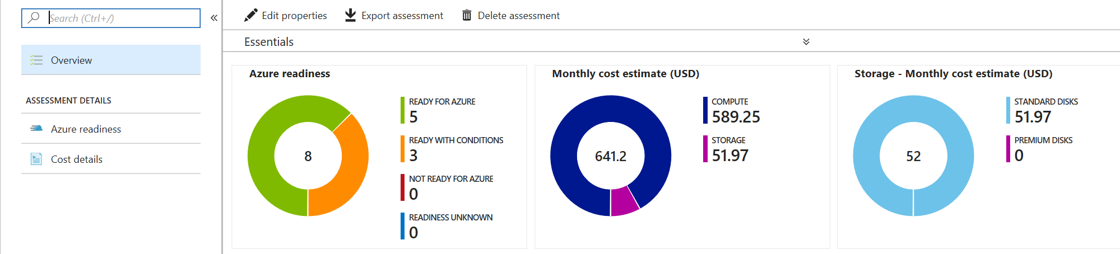
Azure Migrate – Assessment
Identify on-premises machines and workloads, and visualize dependencies
Assess whether on-premises machines are suitable for migration to Azure
Get size recommendations based on current specifications and usage history
Estimate monthly costs
Integrates with ISV migration tools
Notes:
With Azure Migrate’s Assessment, the main goal is to easily identify on-premise workloads that are quick candidates and low hanging fruit as well as potential problems, by looking at the machines, their applications, and the interdependence of those systems. This can help identify the systems that are Ready for Azure, those that need some work or have some conditions, as well as those that just aren’t in a position to move to Azure right now.
Furthermore, the Assessment will also generate a report of the estimated size of the machines and what the estimated costs of compute and storage would be; these are generally the highest cost for most VMs. This is then used to calculate an overall estimation for the monthly cost of the Azure consumption.
In addition, you can export all of the Assessment data for your own review offline, but the data can also be utilized by most ISV’s to directly integrate their tools to take advantage of their enhancements or features as well.

Slide 15





How Azure Migrate Assessments Work
Raw metadata
Processed metadata
Appliance
HTTPS, 443
Assessment
Azure Migrate Service
2. Start discovery
3. Create assessment
Raw metadata
1. Download and configure appliance
Customer
Notes:
Let's take a look at how Azure Migrate works for assessments.
<CLICK> First, you'll download an configure the migration appliance. This process varies depending on your source environment. For VMware, you'll download an OVA and spin up a VM in your cluster that can access the underlying hypervisor hosting your source workloads. For Hyper-V, the process is similar, but you'll download a VHD and deploy a virtual machine. For a physical environment, you'll deploy an IIS site on top of an existing Windows server.
<CLICK> Once your appliance is deployed and configured, it will start collecting raw metadata or telemetry from your source environment. This is known as you starting discovery.
<CLICK> With discovery initiated, the appliance will begin transmitting data about your source to the Azure Migrate service.
<CLICK> As the data is processed, you can begin to use it to create assessments that detail the cost, target sizing, and licensing configuration for your workload.

Slide 16
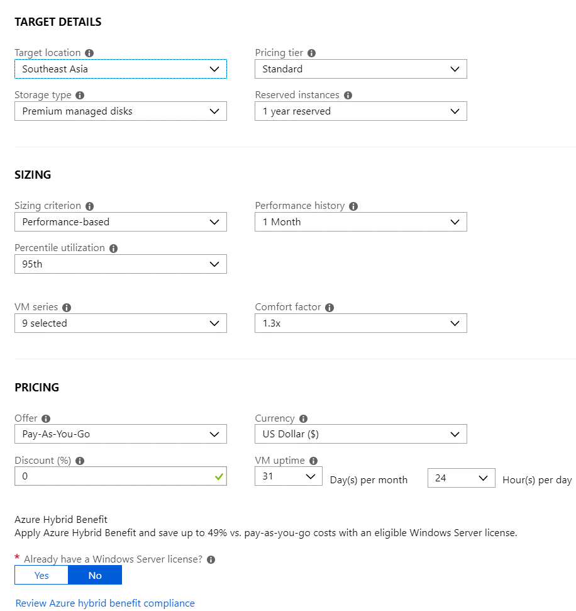
Create Assessment Report
Create VM groups based on known workloads or dependency analysis
Enables migration assessment per group
Configure assessment report
Target region, pricing tier, storage type, and VM series
Sizing based on performance (with comfort factor) or existing specification
Runtime hours per day/month
Pricing plan, EA discount, reserved instances, and hybrid benefit
Notes:
When you create your assessment reports, you'll group one or more VMs together based on the target region, VM size, and storage type.
You can customize your assessments to be performance based where telemetry from your on-premises environment is used to right-size your servers, or you can go with an "as-is" sizing criteria where Azure Migrate will select the server closest in size to your existing workload. It's never going to undersize in an "as-is" assessment, so just be aware of that if you're evaluating servers and they seem to be larger than what you have on-premises.
Your assessments will also present your costs under your pricing agreement. For example, if you're a customer on an Enterprise Agreement and have negotiated a discount with Microsoft as a part of your agreement, that pricing will be reflected here. That's a pretty powerful tool. Even common services like the Azure VM creation blade don't offer pricing under your pricing agreement.

Slide 17
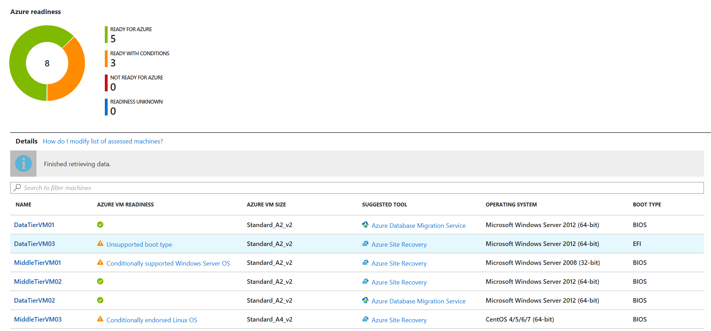

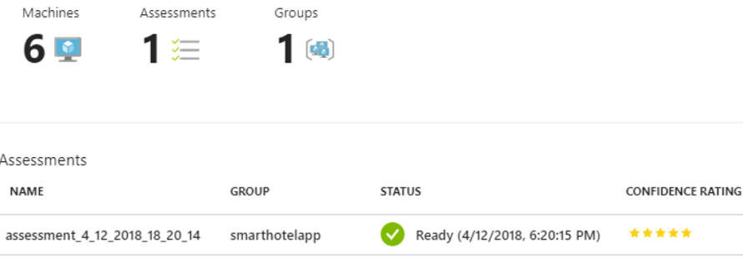
Assessment
Price estimate
Sizing confidence
Azure Readiness
Suggested size
Suggested migration tool
Notes:
When you create your assessment and it's been processed, you can view the readiness of your workload to come to Azure, suggested VM sizing, and a suggested migration tool. I can't stress enough that these are suggestions! If you don't like the size the migration tool has selected for you, you can always change it before you migrate!

Slide 18
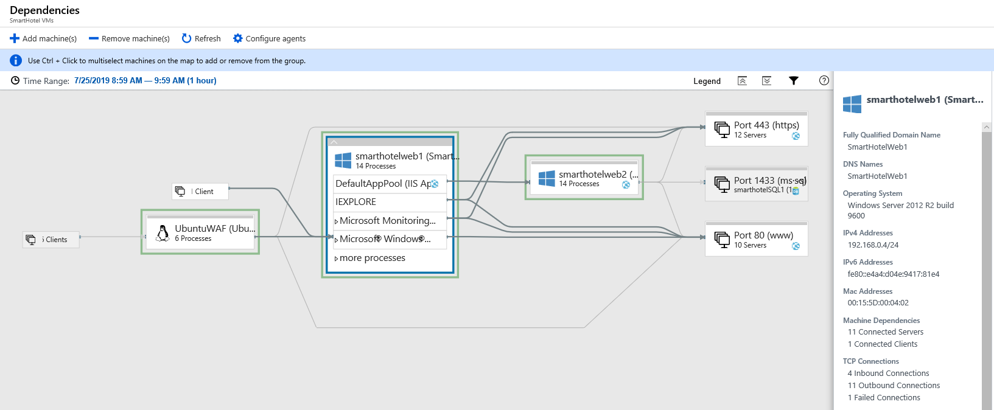
Dependency Visualization
Creates map of VM network dependencies
Requires Microsoft Monitoring Agent and Dependency Agent installed on VMs
Identify related machines to plan migration groups and dependencies
Notes:
Another benefit of using Azure Migrate as your assessment engine is getting free access for 180 days to Log Analytics workspace that is enabled for Service Map. Service Map allows you to view dependency visualizations across your source servers and shows ports, protocols, and programs that interact with each other.
Using Service Map does require that you deploy the Microsoft Monitoring Agent, or MMA, to your source servers as well as the dependency agent. It's easy enough to do by hand for a few servers, but if you need to deploy to anything more than a handful you'll want to automate the deployment of the agents using PowerShell, bash, or some other engine.

Slide 19
Lift-and-Shift Migration
Notes:
Frequently your discussions with the steakholders lead you down the rehost, or lift and shift, path, let's discuss some of your options there.

Slide 20
Migration Process
Infrastructure Build-Out
Deploy Migration Tool
Replicate Data
Testing
End User Cut-Over
(and roll-back plan)
Handover to Operations
Notes:
In general with most rehost upgrades, you’re going to do these 6 general steps.
Build out the infrastructure, networking, groups, security, and other base pieces of the cloud
Then deploy the migration tool, whatever that happens to be, Azure Migrate, ASR, etc
Then begin replicating the data. This usually isn’t just a single copy but more an initial copy followed by small deltas until you’re ready for the actual cutover
Because the next thing we want to do is a take a copy of that data and *test* it in Azure. With the dynamic structure you can normally replicate the entire structure as it will be and fully test your application in Azure before you actually have to move anything and while the on premise equipment continues to run
Once you’ve tested and validated the applications with the owners or QA teams, you can then finally schedule and plan the cutover. As with any major change, you also need to have a roll-back plan, just in case.
Finally once you have completed the migration and the application running stably in Azure, you need to hand off the management to the operations teams.

Slide 21
Build the Foundation
Governance
Network
Storage
Management
Azure Subscription
Subscription and resource management
Access control
Policy
Hub and spoke
Hybrid
Security
Managed or Unmanaged
Premium or standard
Disk or PaaS
Deployment
Monitoring
Updates
Backup
Notes:
Before you do any deployment in Azure, the first step is always building out the foundation. Migrating applications to Azure using Infrastructure-as-a-Service is often the quickest way to move applications to Azure, as well as requiring the least work and presenting the fewest risks.
The foundation of an Azure infrastructure deployment comprises:
Governance/Identity – how will users authenticate and how resources are secured
Network – designing the network for current and future connectivity requirements
Storage – planning for performance, durability, scalability and archival
Management – Resource deployment, monitoring & updates, and backups
All of this is contained within a Subscription. Your organization may choose to deploy to multiple subscriptions and that’s fine, but generally each migration project should be focusing on one or two subscriptions at a time.

Slide 22
Migrating Virtual Machines
Clean Install
Create clean VMs and re-install the application; copy data
Port Existing Disks
Port existing disks to Azure; create new VMs using those disks
Server Migration
Use migration tools to replicate existing servers into Azure
Notes:
When planning to migrate servers to Azure, there are a few of high level approaches you can take.
Do you start with a clean install? Maybe the source system is just not been maintained well or the application doesn’t handle underneath hardware changes. This is where you would create a brand new VM in Azure and then install your solutions as you might have originally done on-premises. Then you can copy over any existing data, etc.
Or…do you port over your existing disks to Azure and bootstrap your virtual machines with these exported disks? This often requires the most downtime and is something usually only done with small systems or maybe a dev environment were timing isn’t important and costs have to be nill.
Or…do you use one of the server migration tools that’s available in Azure? These tools will help you to analyze your current state and offer you solutions for replicating and migrating your workloads to Azure. This is what most people are looking to do in a Lift-and-Shift. These solutions replicate systems on an on-going basis capturing all changes to the system so that when it comes time to actually commit, they can do a simple flip of the system and spin up new VMs.

Slide 23
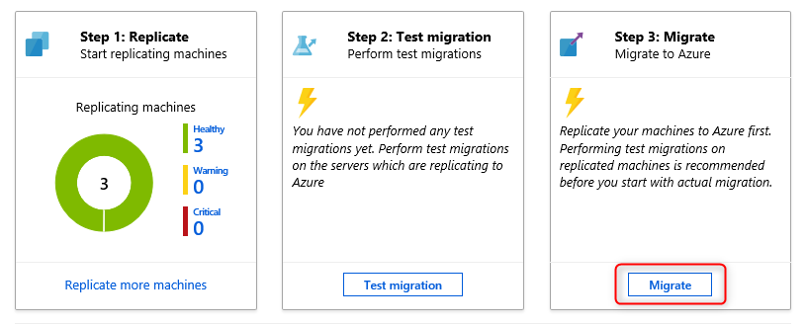
Azure Migrate – Migration
Agentless migration for VMware
Agent-based migration for Hyper-V host and physical servers
Continuous synchronization for minimal downtime
Test migrations
Integrates Microsoft and third party tools
Web App migration
Database migration
Notes:
With Azure Migrate, there is direct integration with V-M-ware to allow agentless migration; meaning we don’t have to install anything on the virtual machines themselves to migrate the OS to Azure.
For Hyper-V and Physical servers, there is an Agent with Azure Site Recovery (ASR) that is used not only for Disaster Recovery, but can also beutilized to migrate the Virtual Machine workloads directly into Azure.
All the Migration tools provide ongoing replication of data to ensure any changes to the local systems are quickly replicated to Azure for copies that are within a few minutes of the on premise systems without affecting their performance. This happens by the local systems identifying any changes of the local disks by catalogue the writes to blocks on the disk and replicating those changes up to Azure. At the point of migration, only a small delta of changes in the last few minutes are need as a final step to bring the machines up to current versions.
In addition, Test Migrations can be performed by replicating your entire systems and running copies of them in Azure without affecting your production environment. This allows you to validate your applications and run QA tests against them by your team to ensure that your applications continue to run or catalogue any changes that need to be made to allow them to function. When the testing is done, you can discontinue the test and no further compute charges are encured until the next test or migration.

Slide 24


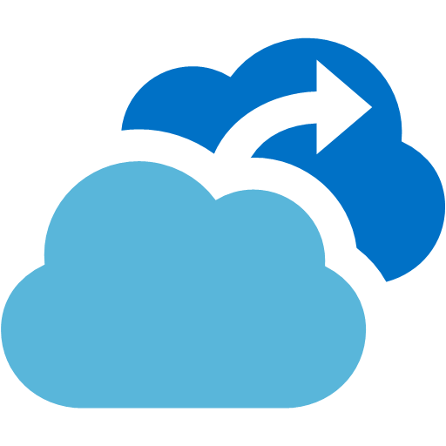
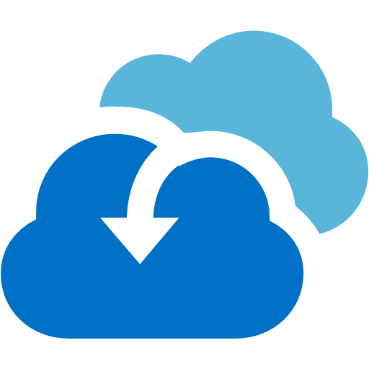
Post-Migration Steps
Install VM Agent / uninstall Mobility Service Agent
Configure backup using Azure Backup and DR using ASR
Check network security groups
Enable Azure Disk Encryption
Review Azure Advisor and Azure Security Center
Enable update and inventory management
Enabling monitoring and alerts
Decommission on-premises systems
Azure Log Analytics
Azure Monitor
Azure Backup
Azure Site Recovery
Notes:
After the migration has been completed and verified, here’s a list of steps that you’ll likely need to perform as well.
Before executing the application migration onto your new Azure infrastructure, the infrastructure must be ready for ongoing production operations.
This includes ensuring that systems for security, backup, high availability and disaster recovery are in place, together with logging and alerting to ensure issues are identified promptly and can be properly investigated.
{read the slide}.
NOTES:
For Windows machines, if you've migrated from physical/Vmware, and you used an up-to-date version (9.7.0.0 or later) of the ASR Mobility Service on the source VM, then the Azure VM Agent will be installed on the migrated VM automatically. This applies to Windows only, for Linux VMs the WALinuxAgent has to be installed manually. (Source: https://docs.microsoft.com/en-us/azure/site-recovery/vmware-azure-install-mobility-service)

Slide 25
Database Migration
Notes:
Finally we have the database migration service, or DMS. Data Migration is not just a DBA job. In many cases, a developer or Infrastructure engineer will be tasked with performing and/or assisting during a database migration. Also, the database sits in an application and infra context, so Infra and Dev engineers play a critical role in the database migration design.

Slide 26
Database Migration Tools
Data Migration Assistant
Azure Database Migration Service
SQL Server Migration Assistant
Assess on-premises SQL Server for migration issues
Migrate to SQL on Azure VMs or Azure SQL Database
Upgrade SQL version
Assess on-premises SQL Server using DMA
Migrate multiple databases at scale
Supports SQL Server, MySQL, PostgreSQL, …
Supports DB2, Oracle, SAP ASE, MySQL, and Access
Migrate to SQL Server or Azure SQL Database
Notes:
There's a few of different tools we'll need to think about, and really it's a spectrum here depending on our source database system.
First, we have the Data Migration Assistant, or DMA. DMA is used to assess on-premises SQL databases for fit in Azure and can also provide some pre-staging migration capabilities such as creating a your database schema in Azure SQL or in SQL on an Azure VM once you're ready to start migrating.
Next, we have the Database Migration Service or DMS. DMS uses DMA as an assessment engine, so I think it's worth just getting hands on with DMA from the start if your looking to migration Microsoft SQL to Microsoft SQL or Azure SQL. DMS is ultimately a compute service that sits on a VNET in Azure and can communicate with your source workload through any site-to-site or vnet-to-vnet connectivity that hosting Vnet has. This means to use DMS to migrate an on-premises database, you'll need a site-to-site or ExpressRoute connection in place so the cloud-hosted service can talk to your on-premises SQL instances.
If you're looking to migrate other types of source databases such as Oracle, SAP ASE, DB2, etc. you'll want to look at the SQL Server Migration Assistant or SSMA. While SSMA can't help you go from say Oracle to Oracle, it can help you transition from Oracle to Azure SQL or Microsoft SQL if that's your desire.

Slide 27
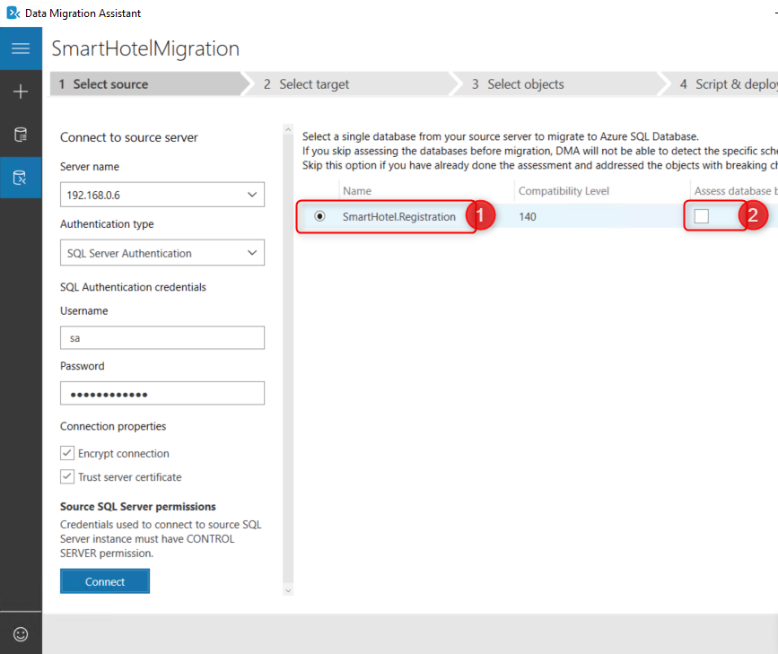
Assessment
Assess compatibility using SQL Server Data Migration Assistant
Download and run DMA v3.3+ on source database
Specify source and destination database types
Select report type (feature parity and/or database compatibility)
Specify source database + credentials
Run assessment and review report
Address blocking issues
Notes:
Once you're ready to run an assessment, you can download DMA. It doesn't need to be run from the server hosting the database, but it does require connectivity to the source database.
When you structure an assessment, you'll specific your source and destination database types. Now, do keep in mind that if you want to assess for another database type, that means you'll need to create another assessment.
Once your assessment is done, you can save the report locally or your can upload it to DMS if you have a DMS instance created.

Slide 28
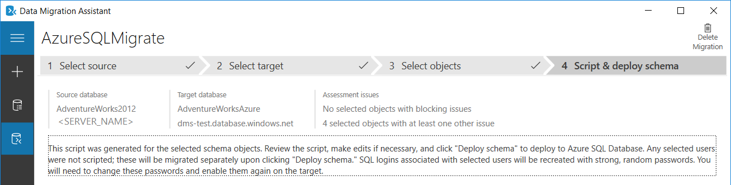
Migrate Schema
Migrate Schema using either DMA or DMS
'Schema only' migration projects
Specify source and target databases + credentials
Notes:
As I mentioned, DMA can do part of your database migration for you, specifically migrating your schema. You can do this through the DMA tool locally, or if you've loaded your assessment to DMS, you can have DMS create the schema as a migration activity.

Slide 29
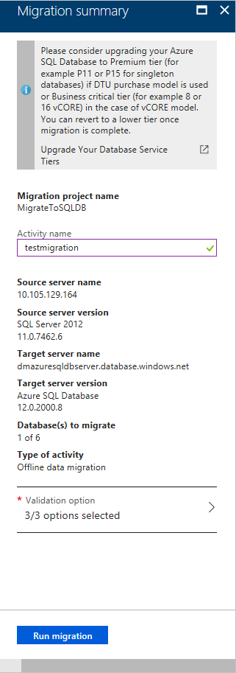
Data Migration with DMS
Enable database connectivity
Use ExpressRoute or VPN to connect source database to DMS VNet
Select Online or offline migration
Online migration synchronizes in-flight transactions
Specify migration source and target servers
Source server FQDN or IP address plus credentials with 'CONTROL SERVER' permissions
Destination credentials require 'CONTROL DATABASE' permissions
Select source and target database mappings
Specify validation options – schema comparison, data consistency, query consistency
Run the migration and monitor progress
Notes:
As I mentioned, DMS is an Azure-hosted service. Ideally, the DMS resource should be placed in the same Azure region as the target database. It can still work from a different region, but will be slower. Personally, I would only do this if the target region is not supported for the DMS.
Once you have DMS provisioned and you've verified connectivity between the VNET it sits on and your source database, it's just a matter of following the wizard, where you'll input the source and target database credentials and then run your migration activity.
DMS allows you to perform both online and offline migrations depending on the level of compute you throw behind your DMS instance. If you select a premium tier with dedicated vCores, online migration is absolutely an option.
https://docs.microsoft.com/en-us/azure/dms/tutorial-sql-server-to-azure-sql

Slide 30
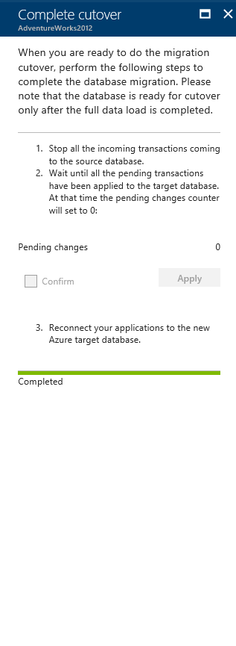
Cutover
Reconfigure applications to use the migrated database
Offline migrations
Reconfigure applications with new database connection details
Online migrations
Select 'Start cutover'
Stop incoming transactions to source database
Wait for 'Pending changes' counter to show '0'
Reconfigure applications with new database connection details
Notes:
Your cutover process varies ever so slightly depending on the type of migration you're performing – online or offline. For an offline migration, terminate any connections to your existing database, perform the migration and during or after the database migration is complete reconfiguration your application (for example, update the connection strings) to point to the new database instance.
For online migrations, you're still responsible for terminating connections to the source database that cause an writes or updates but reads are OK. If you don't do this and you still have new data being written or updated in the database, your migration will never complete. And just like an offline migration, while the migration is in progress, you can update any connection strings to point to the new database instance.
The biggest difference between an online migration and offline migrations is when your downtime starts. With an offline migration, it's as soon as the migration starts because you're going to sever all connections to the source database. With an online migration, downtime can be limited to the time it takes to you cutover at the end of your migration.

Slide 31
New Features
Notes:
There are been several updates to Azure Migration over the last year. Here are just a few of the most recent and interesting updates.

Slide 32
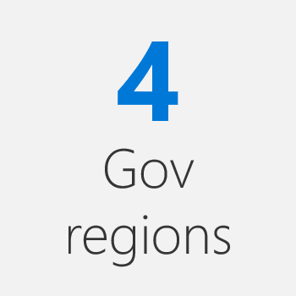
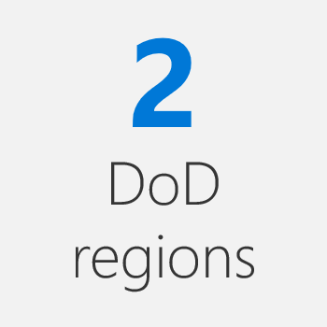
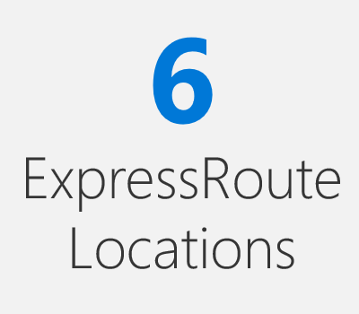
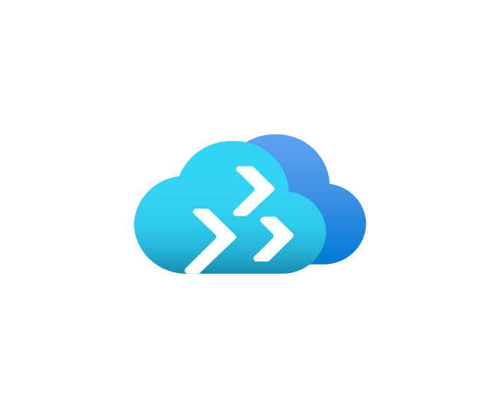
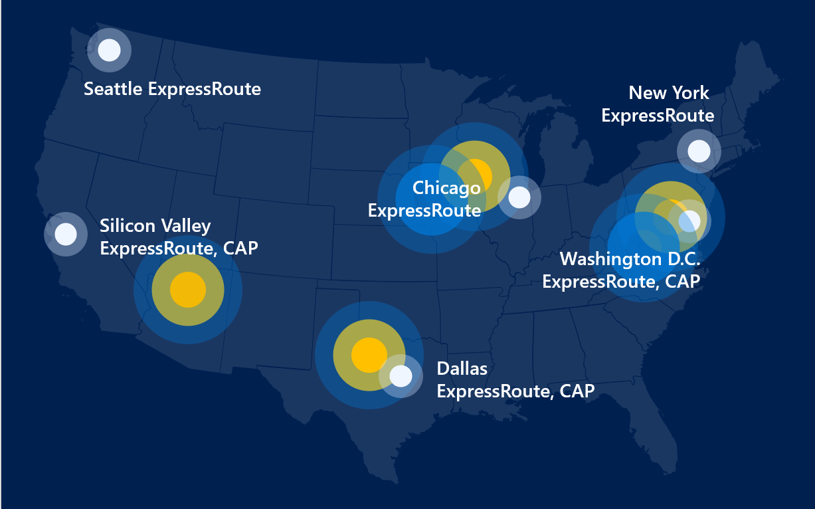
Azure Government
Notes:
As the Azure Government space begins to grow and the federal governments begin to expand into the cloud and more programs such as FedRAMP and JEDI, there will continue to be a great need to find the best & most opportune ways to get existing resources into the cloud in the most efficient way. With Azure’s continue drive to optimize, secure, and certify Azure solutions for the needs of government entities, <CLICK> Azure Migrate is now generally available for both the Azure Government and DoD regions
Apr 18, 2020
https://azure.microsoft.com/en-us/updates/azure-migrate-now-available-in-azure-government/

Slide 33
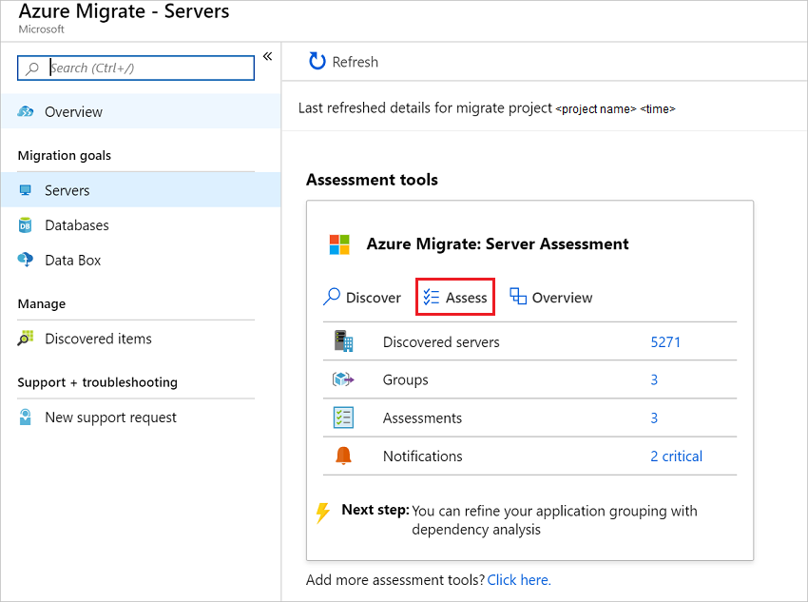
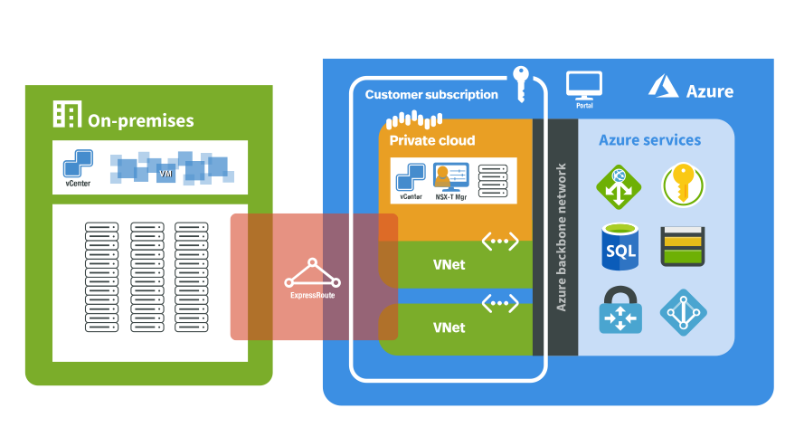
Assessment of Azure VMware (preview)
Notes:
The newly released Azure VMware service allows you to run a Private cloud in the Azure space and utilize VMware tools to manage the environment. To help assess the needs, load, and options of moving on premise services to Azure, Migrate includes an assessment tool to evaluate the systems and applications; however, this currently still in preview only.
Jun 29, 2020
https://azure.microsoft.com/en-us/updates/azure-migrate-azure-vmware-solution-assessment-preview/

Slide 34
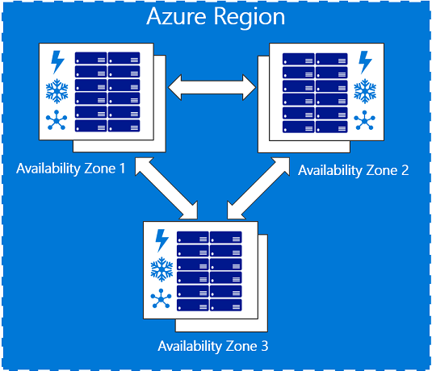
Migrate to Availability Zone
Notes:
As you migrate into Azure, you can now target specific Azure Zones. This allows you to bring in resources and immediately have the available to take advantage of the 99.99% SLA (<1 hour down per year) when you have at least two systems supporting your application.
Sep 03, 2020
https://azure.microsoft.com/en-us/updates/migrate-to-azure-availability-zones/

Slide 35
Growing list of Migrate Features
PowerShell for Azure Migrate
Azure Migrate PowerBI Comparison Dashboard
UEFI-based OSEs supported to Gen 2 VMs in Azure
Agentless performance increase (1000 concurrent VMs, 32 TB Disks)
Option to download either OVA/VHD image or install script
Notes:
https://docs.microsoft.com/en-us/azure/migrate/whats-new
PowerShell has continued to expand and grow in its features and abilities. With the recent release of the Az.Migrate module, you no longer need to make REST API or GUI calls for automating Azure Migrate tasks. The module now gives direct commands to automate, configure, and report on Migrate tasks natively with PowerShell tools
Nov 02, 2020
https://azure.microsoft.com/en-us/updates/powershell-support-for-server-migration-with-azure-migrate/

Slide 36
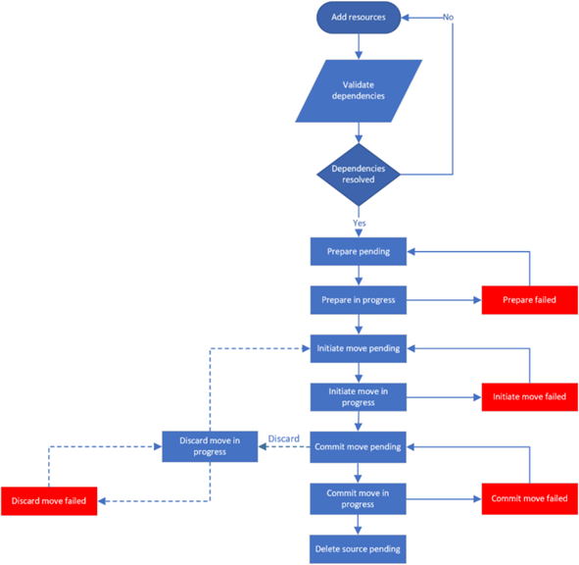
Azure Resource Mover (preview)
Evaluate and move resources between:
Resource Groups/Subscriptions
Regions
Azure Clouds
Availability Zones
Available for both VMs and SQL
Not directly related to Azure Migrate
Select resources
Validate depen-dencies
Prepare for move
Initiate move
Commit or discard move
Delete source
https://docs.microsoft.com/en-us/azure/resource-mover/
Notes:
While not directly related to Azure Migrate, there is a new solution that provides similar services within Azure: Azure Resource Mover. <CLICK> This is a more formal process than the simple Move function of resources between RGs or Subscriptions. It walks through the resources to validate the dependencies, gets them ready, starts the move, then either commits or rolls back the move depending on if the move was successful or not.
Depending on what resources are moved and where they need to be moved, different tools will be utilized. For instance, if you need to move between regions or Availability Zones, the Mover Hub will natively do that. However, if you look to move resources to another cloud (such as Public to Government), it would utilize Site Recovery.
Its still currently in preview, but is worth checking out if you plan to move resources within Azure in the future.
Sep 22, 2020
https://docs.microsoft.com/en-us/azure/resource-mover/

Slide 37

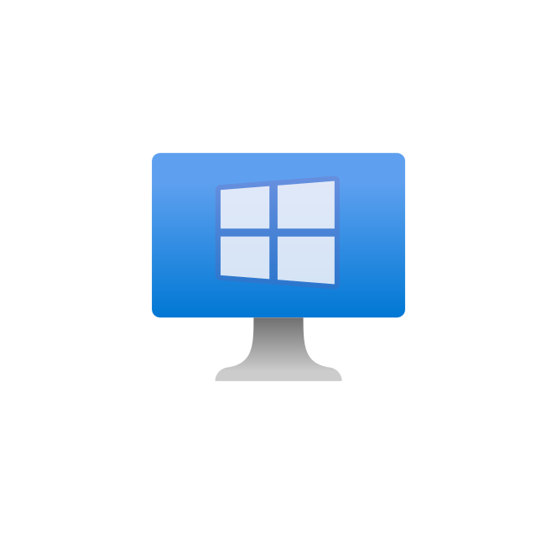
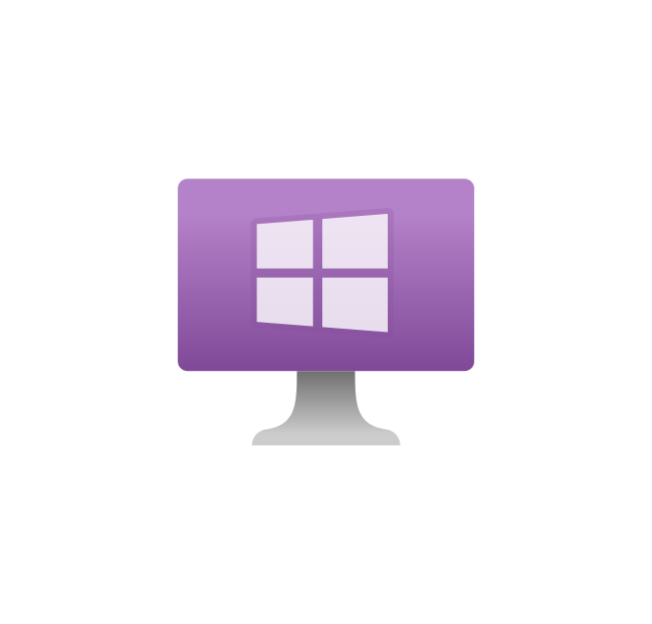


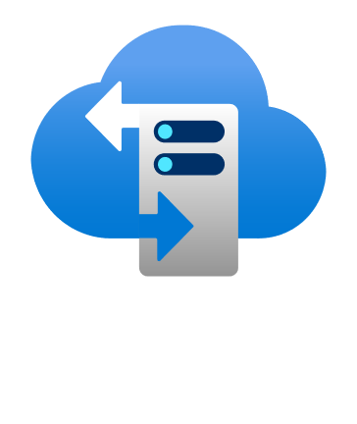

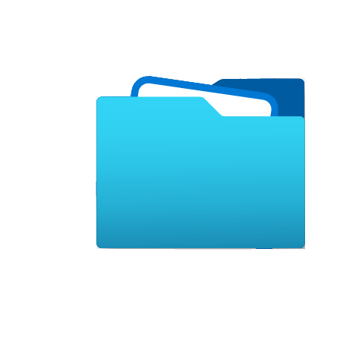
Active Directory support for Azure Files via SMB
AD DS
AD DS
File Share
Storage
Account
File Server
File Sync
On Premise Data Center
Azure Subscription
Notes:
Another feature not directly related to Azure Migrate but useful for a migration is Azure Files now support SMB with traditional Active Directory (AD DS). This allows you to replicate file shares from an on premise Windows file server directly into Azure Files of a Storage Account via File Sync. These can then be accessed via SMBv3 by a domain client and have the same NTFS permissions as on premise.
Obviously, you could replicate a file server via ASR, but this allows you to replicate the files directly into a PaaS service and reduce the cutover time to the time it takes to change clients to point at the Storage Account. If DFS in place, this can be done seamlessly to the clients.
https://azure.microsoft.com/en-us/updates/active-directory-for-authentication-on-smb-access-to-azure-file-in-preview/

Slide 38
Hands on Lab
Notes:
Thanks for attending Operationalizing Azure Kubernetes Service.
My name is [Speaker name].

Slide 39
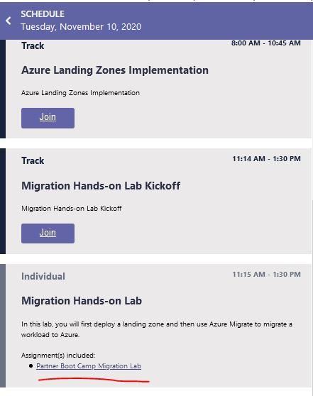
Hands On Lab in VCM
Notes:
Go back to the main VCM screen and go to the Migration Hands-on Lab
Click the Partner Boot Camp Migration Lab
Once the page for the Migration Lab is up, click the Lab Environment link

Slide 40
Thank you.
Notes:
Thanks for attending Operationalizing Azure Kubernetes Service.
My name is [Speaker name].

